Slide 1
Database Resume

Slide 2
Agenda
Tech Stack
Name Entity Recognition (Joseph Casello)
Text2Sql, Topic Modeling (Arjun Moola)
Caption Generation, Text Summarization (MonTrell Nelson)
Resume Template, Multi-label classification (Nicholas Carter)
Demo
Conclusion

Slide 3
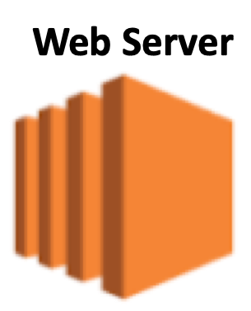

Tech Stack
Resume Auto-Fill
Text-Extraction
NER
Resume Database
Template Generation
192.9.135.43:8000
Resume Chatbot
Text2SQL
192.9.130.183:8000
Topic Modeling
Text Summarization
146.235.218.83:8000

Slide 4
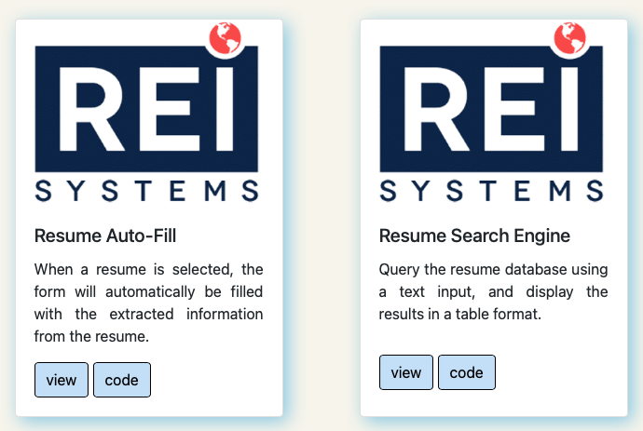
Front-End

Slide 5
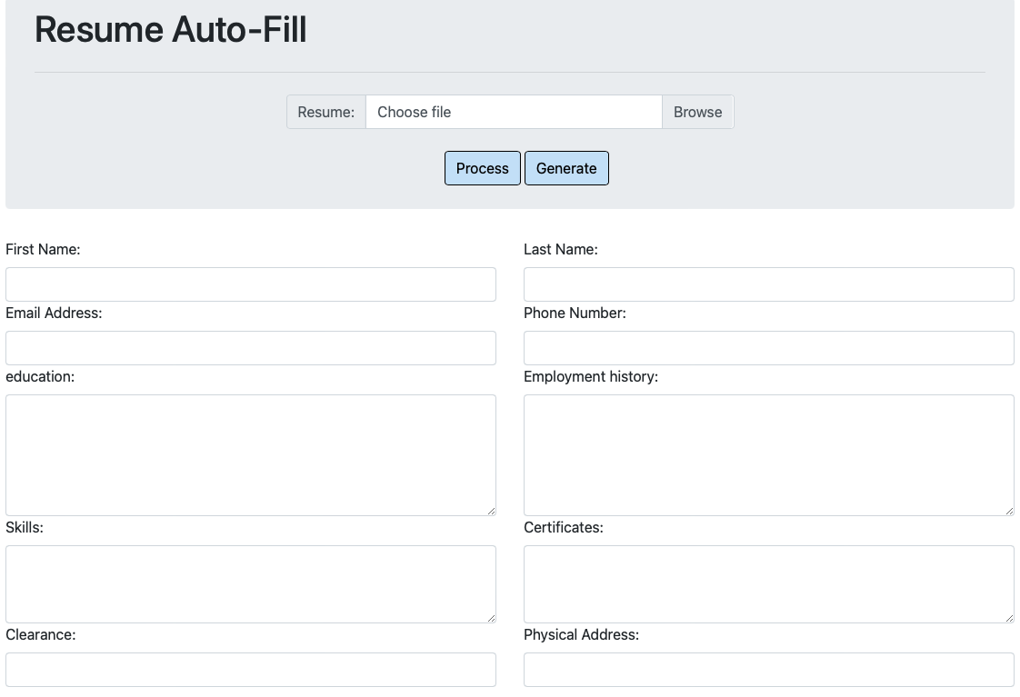
Resume Auto-Fill

Slide 6
Resume Auto-Fill (Joseph)
Resume Database
Refined Resume Database
First Name
Last Name
Security Clearance
Education
Employ history
Certificates
Summary of expertise
…
R_D
NER
R_R_D

Slide 8
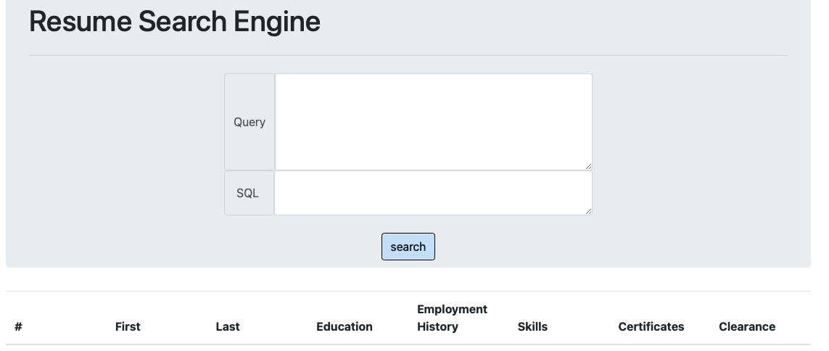
Resume Chatbot (Arjun)

Slide 9
R_D
R_R_D
Text to SQL
description
Retrieved Records

Slide 12
Caption Generation (MonTrell)

Slide 14
Text Summarization (MonTrell)

Slide 16
Template Generation (Nicholas)

Slide 18
Multi-label classification (Nicholas)

Slide 20


IT Service Management
Delivering
Impact
Through Technology Innovation
Thank you!
45335 Vintage Park Plaza
Sterling, VA 20166
703.480.9100
info@reisystems.com
www.reisystems.com
20000-1:2011
27001:2013
9001:2015
Capability Maturity Model
Information Security
Quality
Assurance

Slide 21
Second Step (second solution)
Semantic
Keyword
matching
Resume Desc.
Summarization
R_R_D
RFP/description
Topic Modeling
Topic Modeling
Rankings

